Slide 1
Relational Databases
Chapter 4

Slide 2
Databases
Database systems were developed to address the problems associated with the proliferation of master files.
  For years, each time a new information need arose, companies created new files and programs.
  The result: a significant increase in the number of master files.

Slide 3
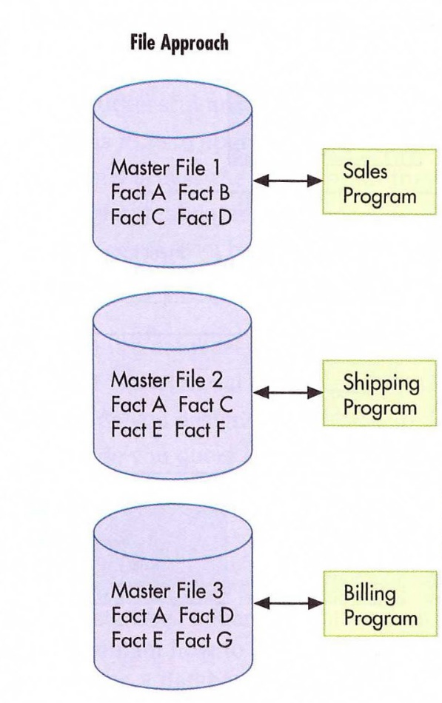
File Approach vs Database
Approach
This proliferation of master files created problems:
  Often the same information was stored in multiple master files.
  Made it more difficult to effectively integrate data and obtain an organization-wide view of the data.
  Also, the same information may not have been consistent between files.
    If a student changed his phone number, it may have been updated in one master file but not another.

Slide 4
Database Approach
The database approach treats data as an organizational resource that should be used by and managed for the entire organization, not just a particular department.
A database is a set of inter-related
centrally coordinated files.

Slide 5

Database Management
Database Management Systems
  serves as the interface between the
  database and the various application
  programs.
Database Administrator
  The person responsible for the
  database
The combination of the database, the DBMS, and the application programs that access the database is referred to as the database system.
Database
system

Slide 6
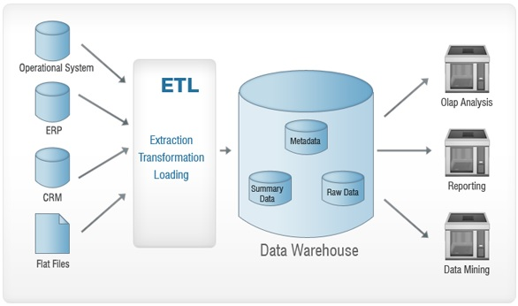
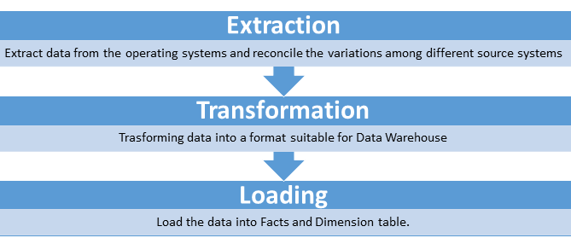
Data Warehouses
As technology improves, many large
companies are developing very large
databases called data warehouses
  data warehouses: a large store of data accumulated from a wide range of sources within a company and used to guide management decisions
Business Intelligence
  Reporting
  Online Analytical Processing
  Data Mining

Slide 7
Advantages of Databases
Database technology provides the following benefits to organizations:
  Data integration
Achieved by combining master files into larger pools of data accessible by many programs.

Slide 8
Advantages of Databases
Database technology provides the following benefits to organizations:
  Data integration
  Data sharing
It’s easier to share data that’s integrated

Slide 9
Advantages of Databases
Database technology provides the following benefits to organizations:
  Data integration
  Data sharing
  Reporting flexibility
Reports can be revised easily and generated as needed.
The database can easily be browsed to research problems or obtain detailed information.

Slide 10
Advantages of Databases
Database technology provides the following benefits to organizations:
  Data integration
  Data sharing
  Reporting flexibility
  Minimal data redundancy and inconsistencies
Because data items are usually stored only once.

Slide 11
Advantages of Databases
Database technology provides the following benefits to organizations:
  Data integration
  Data sharing
  Reporting flexibility
  Minimal data redundancy and inconsistencies
  Data independence
Data items are independent of the programs that use them - a data item can be changed without changing the program and vice versa.

Slide 12
Advantages of Databases
Database technology provides the following benefits to organizations:
  Data integration
  Data sharing
  Reporting flexibility
  Minimal data redundancy and inconsistencies
  Data independence
  Central management of data
Data management is more efficient because the database administrator is responsible for coordinating, controlling, and managing data.

Slide 13
Advantages of Databases
Database technology provides the following benefits to organizations:
  Data integration
  Data sharing
  Reporting flexibility
  Minimal data redundancy and inconsistencies
  Data independence
  Central management of data
  Cross-functional analysis
Relationships can be explicitly defined and used in the preparation of management reports

Slide 14
Database Users
Database systems separate the storage and use of data elements.
  Two separate views of the data are provided:
    Different users of the database information are at an external level of the database. These users have logical views of the data
      logical views : How the user or programmer conceptually organizes and understands the data
    At an internal level of the database is the physical view of the data
      physical views : How and where the data are physically arranged and stored
      Database administrators are generally concerned with the physical view.

Slide 15
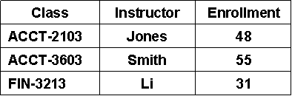
Database Users
Enrollment by Class
Scholarship Distribution
Fr.
Sr.
5%
Soph.
33%
24%
Jr.
38%
DBMS
The DBMS translates users’ logical views into instructions as to which data should be retrieved from the database.
Operating
System
Database

Slide 16
Database Users
Enrollment by Class
Scholarship Distribution
Fr.
Sr.
5%
Soph.
33%
24%
Jr.
38%
DBMS
The operating system translates DBMS requests into instructions to physically retrieve data from various disks.
Operating
System
Database

Slide 17
Schemas
Schemas is a description of the data elements in a database, the relationships among them, and the logical model used to organize and describe the data.
There are three levels of schema.
    Conceptual level
The organization-wide view of the entire database—i.e., the big picture.
Lists all data elements and the relationships between them.

Slide 18
Schemas
Smith . . . A
Jones . . . B
Arnold . . .D
Mapping external-level views to conceptual-level schema
Classes
Enroll
Student
Cash
Receipt
Mapping conceptual-level items to internal-level descriptions

Slide 19
Schemas
Schemas is a description of the data elements in a database, the relationships among them, and the logical model used to organize and describe the data.
There are three levels of schema.
    Conceptual level
    External level
A set of individual user views of portions of the database, i.e., how each user sees the portion of the system with which he interacts.
These individual views are referred to as subschema.

Slide 20
Schemas
Smith . . . A
Jones . . . B
Arnold . . .D
Mapping external-level views to conceptual-level schema
Classes
Enroll
Student
Cash
Receipt
Mapping conceptual-level items to internal-level descriptions

Slide 21
Schemas
Schemas is a description of the data elements in a database, the relationships among them, and the logical model used to organize and describe the data.
There are three levels of schema.
    Conceptual level
    External level
    Internal level
A low-level view of the database.
It describes how the data are actually stored and accessed including:
  Record layouts
  Definitions
  Addresses
  Indexes

Slide 22
Schemas
Smith . . . A
Jones . . . B
Arnold . . .D
Mapping external-level views to conceptual-level schema
Classes
Enroll
Student
Cash
Receipt
Mapping conceptual-level items to internal-level descriptions

Slide 23
Database Design
To design a database, you need to have a conceptual view of the entire database. The conceptual view illustrates the different files and relationships between the files.
The data dictionary is a “blueprint” of the structure of the database and includes data elements, field types, programs that use the data element, outputs, and so on.
Accountants should participate in the development of the data dictionary because they have a good understanding of the data elements in a business organization, as well as where those elements originate and how they are used

Slide 24
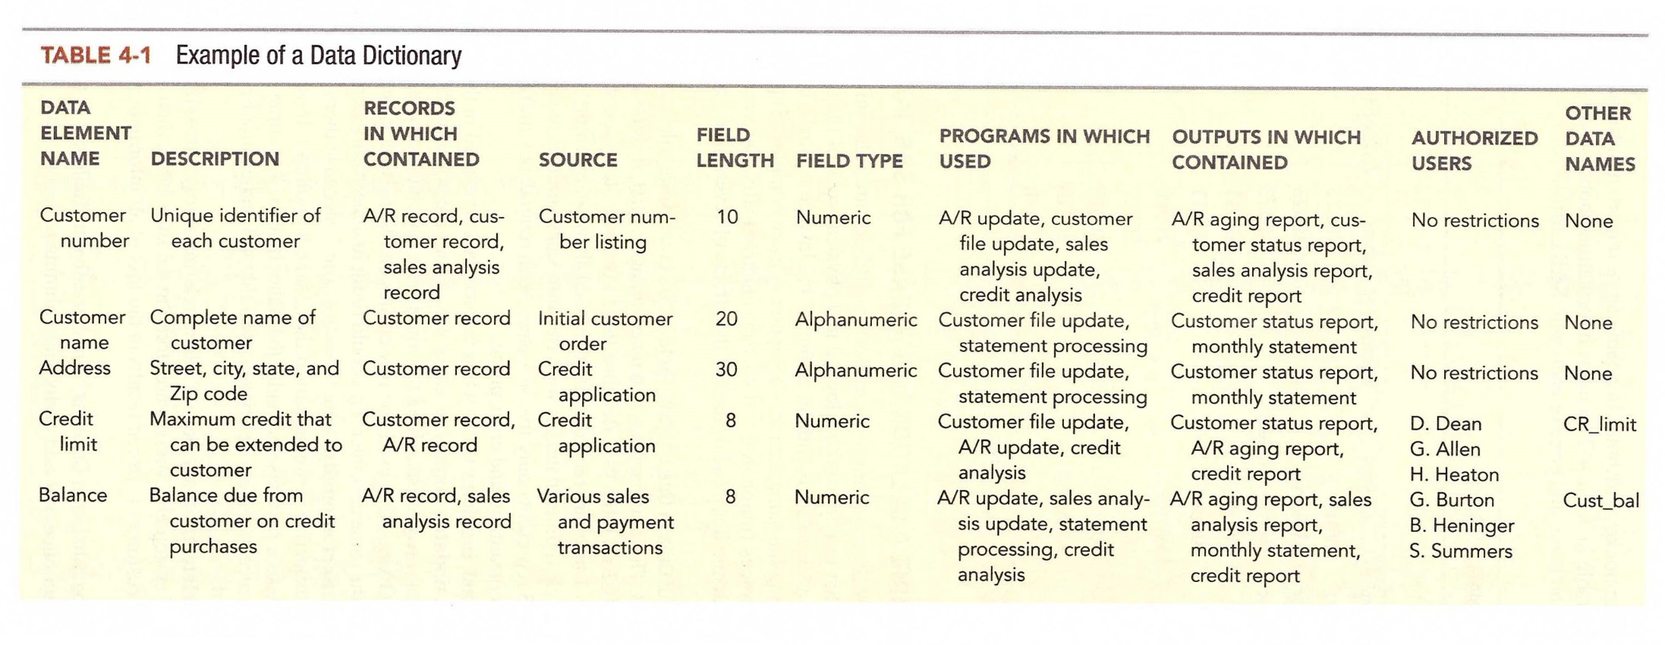
Database Design

Slide 25
DBMS Languages
Data Definition Language (DDL)
  Builds the data dictionary
  Creates the database
  Describes logical views for each user
  Specifies record or field security constraints
Data Manipulation Language (DML)
  Changes the content in the database
    Creates, updates, insertions, and deletions
Data Query Language (DQL)
  Enables users to retrieve, sort, and display specific data from the database

Slide 26
DBMS Languages
Report Writer
  Many DBMS packages also include a Report Writer, a language that simplifies the creation of reports.
  Users typically specify:
    What elements they want printed
    How the report should be formatted
  The report writer then:
    Searches the database
    Extracts specified data
    Prints them out according to specified format

Slide 27
Relational Database
Relational data model
  Represents the conceptual and external schema as if that “data view” were truly stored in one table.
  Although the conceptual view appears to the user that this information is in one big table, it really is a set of tables that relate to one another.

Slide 28
Conceptual View Example
Customer Name | Sales Invoice # | Invoice Total
D. Ainge | 101 | $1,447
G. Kite | 102 | $4,394
D. Ainge | 103 | $ 898
G. Kite | 104 | $ 789
F. Roberts | 105 | $3,994

Slide 29
Relational Data Tables

Slide 30
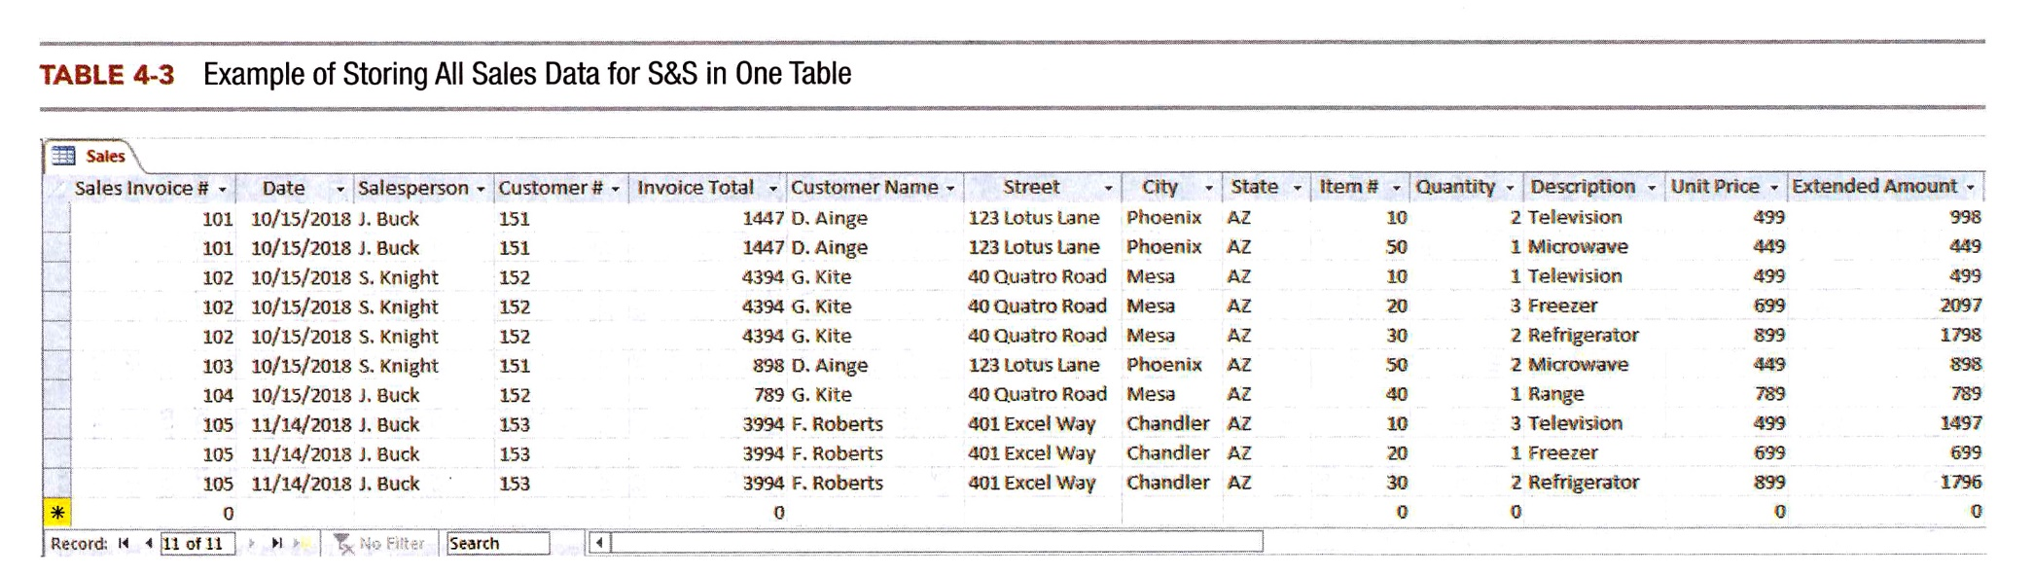
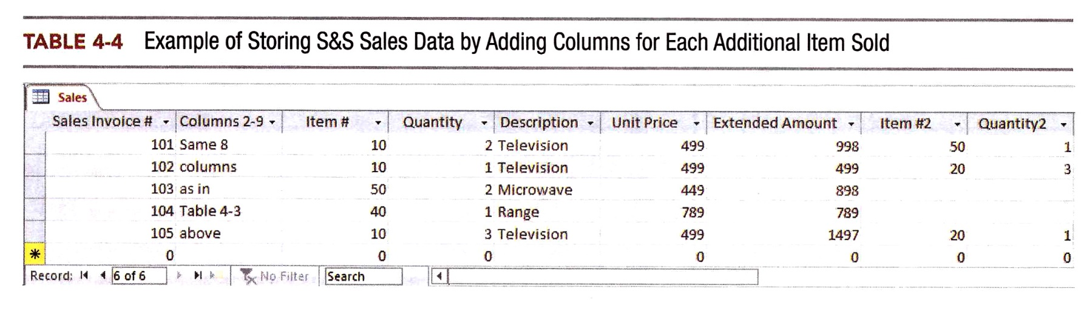
Designing a Relational Database
Data stored in one large table can be redundant and inefficient causing the following problems:
  Update anomaly
  Insert anomaly
  Delete anomaly

Slide 31
Basic requirements
  Every column in a row must be single valued.
    In other words, every cell can have one and only one value.
    In the student table, you couldn’t have an attribute named “Phone Number” if a student could have multiple phone numbers.
    There might be an attribute named “local phone number” and an attribute named “permanent phone number.”
    You could not have an attribute named “Class” in the student table, because a student could take multiple classes.

Slide 32
Basic requirements
  The primary key cannot be null.
    The primary key uniquely identifies a specific row in the table, so it cannot be null, and it must be unique for every record.
    This rule is referred to as the entity integrity rule.
  A foreign key must either be null or correspond to the value of a primary key in another table.
    This rule is referred to as the referential integrity rule.
    The rule is necessary because foreign keys are used to link rows in one table to rows in another table
  All non-key attributes in a table should describe a characteristic of the object identified by the primary key.
    Could nationality be a non-key attribute in the student table?
    Could advisor’s nationality be a non-key attribute in the student table?

Slide 33
Basic requirements
Primary Keys Foreign Key (Customer # is a Foreign key in the Sales table because it is a Primary key that uniquely identifies Customers in the Customer table). Because of this, the Sales table can relate to the Customer table

Slide 34
Two Approaches to Database Design
One approach is called normalization
  free of update, insert, and delete anomalies
Another alternative way to design well-structured relational databases involves semantic data modeling
  Drawing a graphical picture of what should be included in the database
  Uses the designer’s knowledge about business processes and practices; it therefore facilitates efficient design of transaction processing databases

Slide 35
Queries
Users may want specific information found in a relational database and not have to sort through all the files to get that information. So they query (ask a question) the data.
An example of a query might be: What are the invoices of customer D. Ainge and who was the salesperson for those invoices?

Slide 36
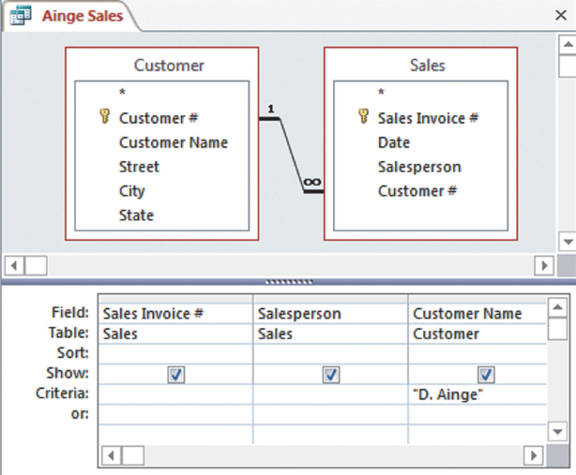
Creating the Query

Slide 37
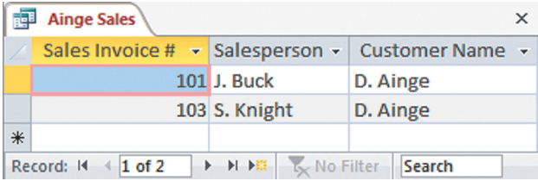
Query Answer

Slide 38
Database systems and the
future of accounting
The use of accounting information in decision making will be enhanced by:
  Powerful querying capabilities that accompany database packages.
  The ability to accommodate multiple views of the same underlying phenomenon.
  The ability to integrate financial and operational data.
Accountants must become knowledgeable about databases so they can participate in developing the AIS of the future.
They must help ensure that adequate controls are included to safeguard the data and assure its reliability.

