Slide 1
Overview of Transaction Processing and Enterprise Resource Planning Systems
Chapter 2

Slide 2
THE DATA PROCESSING CYCLE
An important function of the AIS is to efficiently and effectively process the data about a company’s transactions.
  In manual systems, data is entered into paper journals and ledgers.
  In computer-based systems, the series of operations performed on data is referred to as the data processing cycle.

Slide 3
Data Processing Cycle

Slide 4
Data Input
The first step in data processing is to capture the data
Capture transaction data triggered by a business activity (event).
Data collected for an activity includes:
  Activity of interest (e.g., sale)
  Resources affected (e.g., inventory and cash)
  People who participated (e.g., customer and employee)
Information comes from source documents.

Slide 5
Source Documents
Captures data at the source when the transaction takes place
  Paper source documents
    The data from paper-based will eventually need to be transferred to the AIS - e.g., a sales-order form
  Turnaround documents
    Usually paper-based
    Are sent from organization to customer and same document is returned by customer to organization
  Source data automation (captured data from machines, e.g., Point of Sale scanners at grocery store)

Slide 6
Source Documents
Well-designed source documents can ensure that data captured is
  Accurate
    Provide instructions and prompts
    Drop-down boxes
  Complete
    Internal control support

Slide 7
Data Storage
Important to understand how data is organized
  Paper Based
    General ledger (Summary level accounts)
    Subsidiary ledgers (Specific A/R Accounts)
    Chart of accounts (List of all GL Accounts)
    Transaction journals (Sales)
  Audit Trial: With sufficient documentation (above) one can trace the path of the transaction from beginning to end (Tracing) or from the end back to the beginning (vouching).

Slide 8
Coding Techniques
Coding is the systematic assignment of numbers or letters to items to classify and organize them.
  With sequence codes, items are numbered consecutively to ensure that there will be no gaps in the sequence.
  With a block code, blocks of numbers within a numerical sequence are reserved for categories having meaning to the user
  Group codes are often used in conjunction with the block code
Guidelines for a better coding system
  Consistency – Growth - Simplicity

Slide 9
Computer-Based Storage
  Entity
    Person, place, or thing (Noun)
    Something an organization wishes to store data about
  Attributes
    Characteristics of interest about the entity
  Fields
    Where attributes are stored
  Records
    Group of related attributes about an entity
  Data Value
    the intersection of the row and column.
  File
    Group of related records

Slide 10
Computer-Based Storage
Data is stored in master files or transaction files.

Slide 11
File Types
Two main types:
  Transaction
    Contains business records for a specific period of time
    The files are temporary.
  Master
    a Permanent file that stores cumulative information about an organization’s entities
    Updated by transaction with the transaction file
Database
  Set of interrelated files
Transaction File
Master before Update
Updated Master File

Slide 12
Data Processing
Once data about a business activity has been collected and entered into a system, it must be processed
Four types of processing (CRUD):
Creating new records (e.g., adding a customer)
Reading existing data
Updating previous record or data
Deleting data
Data processing can be batch processed (e.g., post records at the end of the business day) or in real-time (process as it occurs).

Slide 13
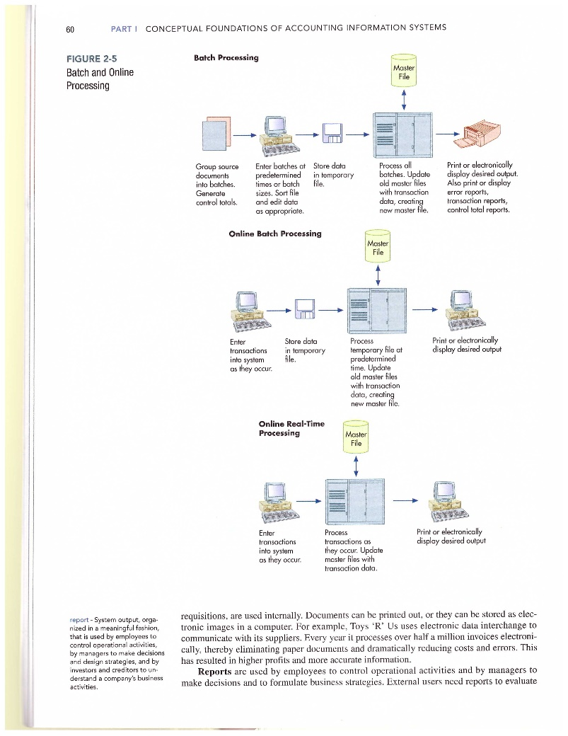

Data Processing

Slide 14
Information Output
The data stored in the database files can be viewed
Online (soft copy)
Printed out (hard copy)
  Document (e.g., sales invoice)
  Report (e.g., monthly sales report)
  Query (question for specific information in a database, e.g., Which division had the most sales for the month?)

Slide 15
Information Output
Output can serve a variety of purposes:
  Financial statements can be provided to both external and internal parties.
  Some outputs are specifically for internal use:
    For planning purposes
Examples of outputs for planning purposes include:
  Budgets
    Budgets are an entity’s formal expression of goals in financial terms.
  Sales forecasts

Slide 16
Information Output
Output can serve a variety of purposes:
  Financial statements can be provided to both external and internal parties.
  Some outputs are specifically for internal use:
    For planning purposes
    For management of day-to-day operations
Example: Delivery schedules

Slide 17
Information Output
Output can serve a variety of purposes:
  Financial statements can be provided to both external and internal parties.
  Some outputs are specifically for internal use:
    For planning purposes
    For management of day-to-day operations
    For control purposes
Performance reports are outputs that are used for control purposes.
These reports compare an organization’s standard or expected performance with its actual outcomes.

Slide 18
Information Output
Output can serve a variety of purposes:
  Financial statements can be provided to both external and internal parties.
  Some outputs are specifically for internal use:
    For planning purposes
    For management of day-to-day operations
    For control purposes
    For evaluation purposes
These outputs might include:
  Surveys of customer satisfaction.
  Reports on employee error rates.

Slide 19
Enterprise Resource Planning
(ERP) Systems
The traditional AIS capture financial data.
  Enterprise resource planning (ERP) systems are designed to integrate all aspects of a company’s operations (including both financial and non-financial information) with the traditional functions of an AIS.

Slide 20
Enterprise Resource Planning
(ERP) Systems
Integrates activities from the entire organization
  Revenue Cycle
  Expenditure Cycle
  Production Cycle
  H/R Payroll Cycle
  General Ledger and Reporting System

Slide 21
Enterprise Resource Planning
(ERP) Systems
Integrate an organization’s information into one overall AIS
ERP modules:
  Financial
  Human resources and payroll
  Order to cash
  Purchase to pay
  Manufacturing
  Project management
  Customer relationship management
  System tools

Slide 22
Advantages of ERP System
Integration of an organization’s data and financial information
Data is captured once
Greater management visibility, increased monitoring
Better access controls
Standardizes business operating procedures
Improved customer service
More efficient manufacturing

Slide 23
Disadvantages of ERP System
Costly
Significant amount of time to implement
Complex
User resistance (learning new things is sometimes hard for employees)
Changes to an organization’s existing business processes can be disruptive

