Slide 1
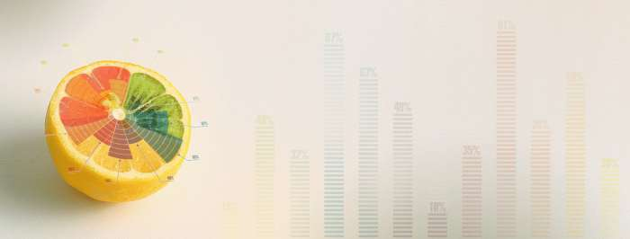
DATA VISUALIZATION

Slide 2
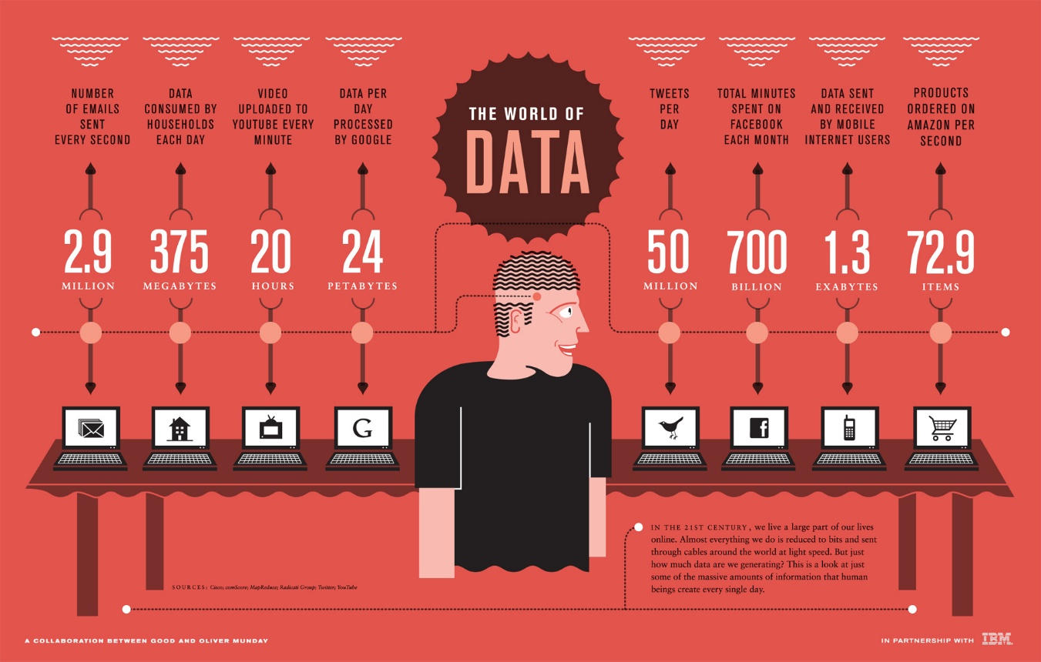

Slide 3
INTRODUCTION
Many forms of data are emerging, which include photos, videos, voice, social media, and e-mails.
Businesses are so overwhelmed by the amount and variety of data cascading into and through their operations
This is creating unprecedented opportunities for businesses to achieve deeper, faster insights that can strengthen decision making

Slide 4
DATA MINING
Exploration & analysis, by automatic or semi‐automatic means, of large quantities of data in order to discover meaningful patterns.

Slide 9
DISCUSSION AND CONCLUSION

Slide 10
WHAT IS DATA VISUALIZATION
Data visualization is the process of converting raw data into some visual form allowing the human to get insight into the data and draw conclusions

Slide 11
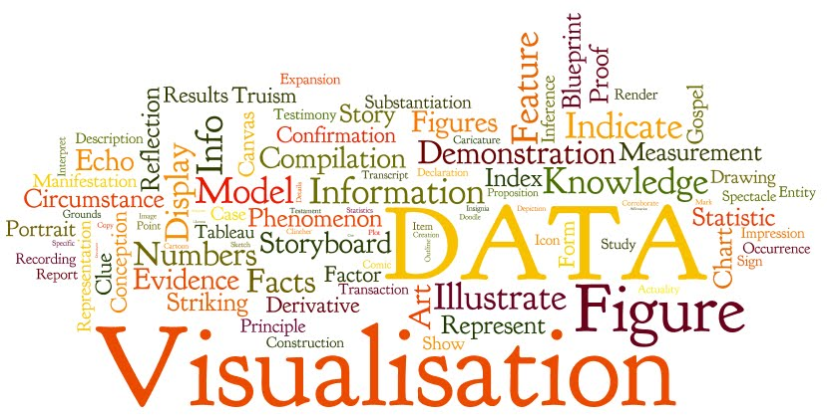
BENEFITS OF DATA VISUALIZATION
Data Visualizations is intuitive and requires little understanding of complex mathematical or statistical algorithms
Data Visualizations usually allows for faster data exploration and often provides better results
Data visualization offers the ability to note outliers in the data
Data visualization allows users see several different perspectives of the data.

Slide 12
BENEFITS OF DATA VISUALIZATION
2 | 4 | 6 | 5 | 8 | 4 |  | 4 | 2 | 3
4 | 5 | 6 | 2 | 1 | 1 | 4 | 5 | 9 | 4
8 | 7 | 4 | 2 | 6 | 9 | 0 | 6 | 4 | 2
3 | 4 | 5 | 3 | 4 | 5 | 8 | 0 | 9 | 8
1 | 7 | 3 | 7 | 6 | 8 | 9 | 6 | 7 | 6
3 | 3 | 6 | 8 | 9 | 3 | 1 | 2 | 1 | 5
8 | 9 | 7 | 6 | 5 | 6 | 4 | 2 | 4 | 5
9 | 8 | 8 | 6 | 5 | 4 | 3 | 2 | 2 | 1
2 | 4 | 6 | 5 | 8 | 4 | 5 | 4 | 2 | 3
4 | 5 | 6 | 2 | 1 | 1 | 4 | 5 | 9 | 4
8 | 7 | 4 | 2 | 6 | 9 | 0 | 6 | 4 | 2
3 | 4 | 5 | 3 | 4 | 5 | 8 | 0 | 9 | 8
1 | 7 | 3 | 7 | 6 | 8 | 9 | 6 | 7 | 6
3 | 3 | 6 | 8 | 9 | 3 | 1 | 2 | 1 | 5
8 | 9 | 7 | 6 | 5 | 6 | 4 | 2 | 4 | 5
9 | 8 | 8 | 6 | 5 | 4 | 3 | 2 | 2 | 1
Number 7:
Count = 5
Location = C2R3, C2R5, C4R5, C9R5, C7R3
Outlier?

Slide 13
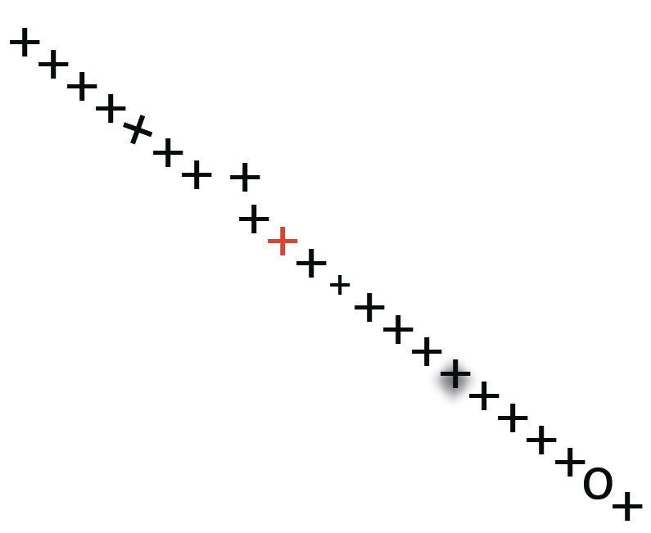
BENEFITS OF DATA VISUALIZATION
Detecting pattern violations
What can you detect in this picture:
Any patterns or pattern violations may be easily detected such as:
Trends – gaps – outliers
Skew
Position
Color
Size
Blur
Shape

Slide 14
EXAMPLES OF DATA VISUALIZATION
Bar Chart
A bar chart is a simple way to visualize data where they contain rectangular bars with lengths proportional to the values that they represent

Slide 15
EXAMPLES OF DATA VISUALIZATION
Bubble Chart
A bubble chart is represented by showing data points as bubbles, and additional dimensions are represented in terms of bubble size and/or color

Slide 16
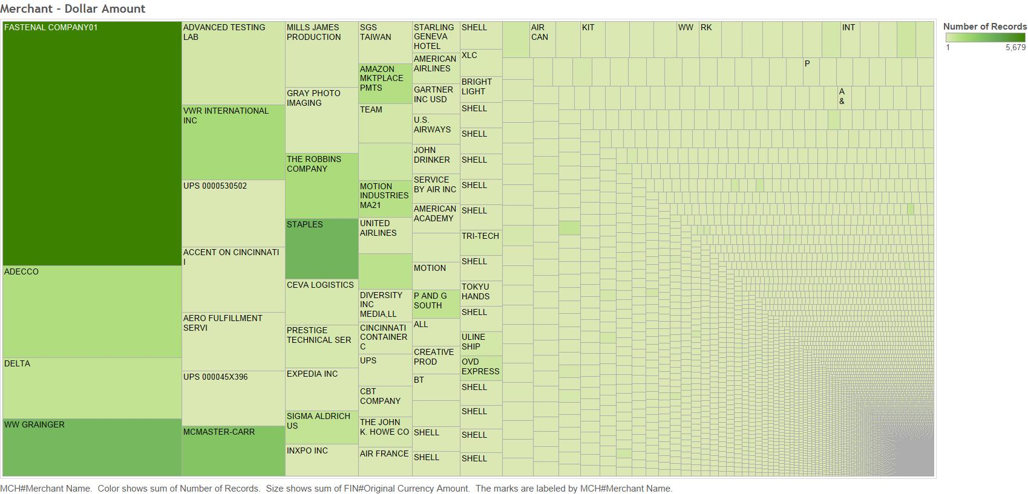
EXAMPLES OF DATA VISUALIZATION
Heat Maps
A heat map is a graphical representation of data where values are presented in a matrix and represented by colors

Slide 17
EXAMPLES OF DATA VISUALIZATION
Map/Geographic Visuals (Geovisualization)
Geographic visualization refers to a set of tools and techniques supporting geospatial data analysis

Slide 18
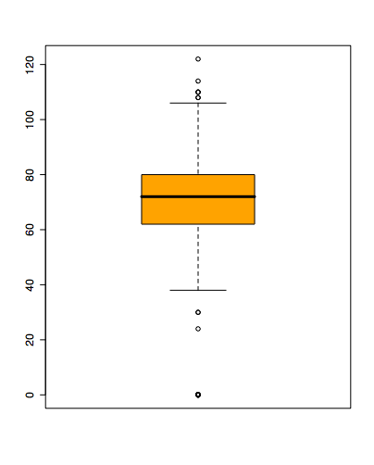
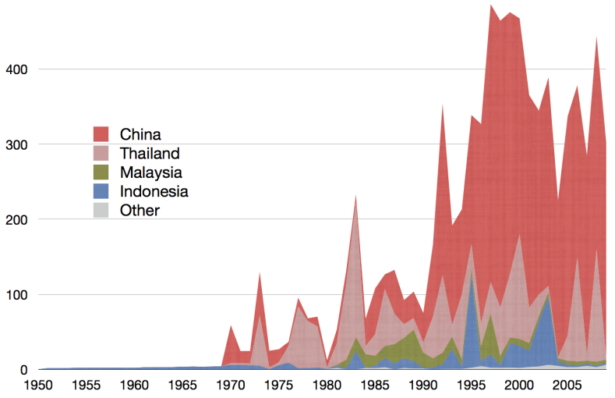
EXAMPLES OF DATA VISUALIZATION
Boxplots
Shows a lot of information about a variable in one plot
Median
Range
Outliers
Time Series
Sequence of data points, measured typically at successive points in time

Slide 19
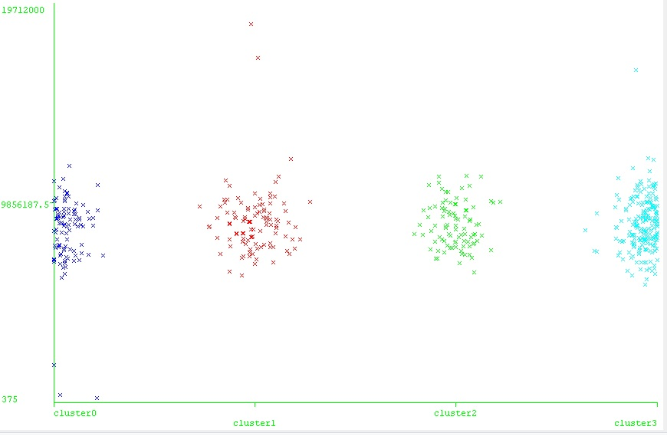
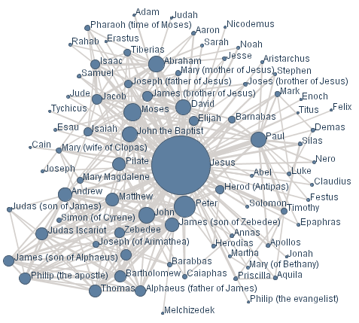
EXAMPLES OF DATA VISUALIZATION
Clustering
The task of grouping a set of objects in such a way that objects in the same group are more similar to each other than to those in other groups
Networks Graphs
Visualizing structures used to model pairwise relations between objects

Slide 20
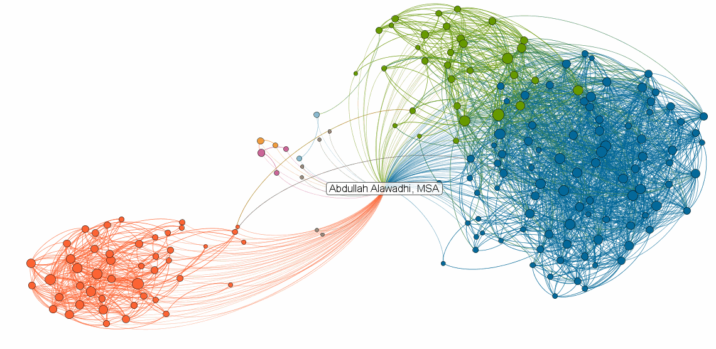
EXAMPLES OF DATA VISUALIZATION
Clustering networks

Slide 21
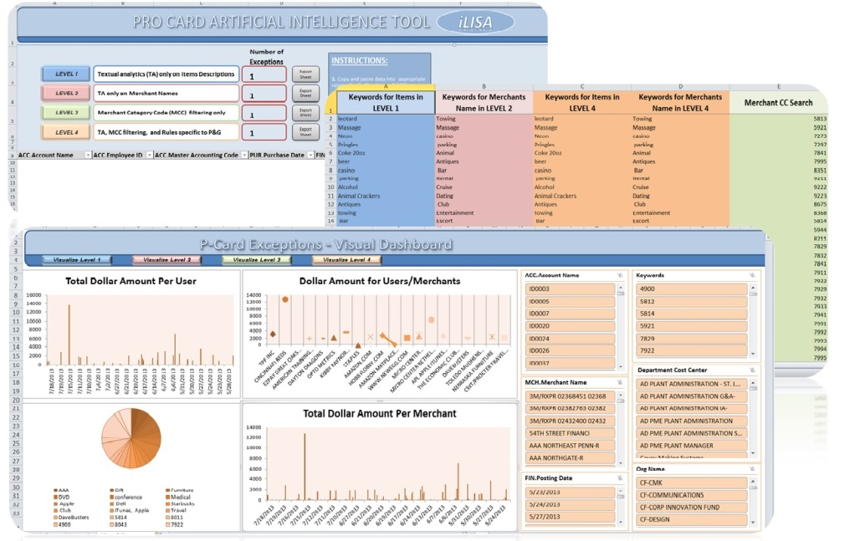
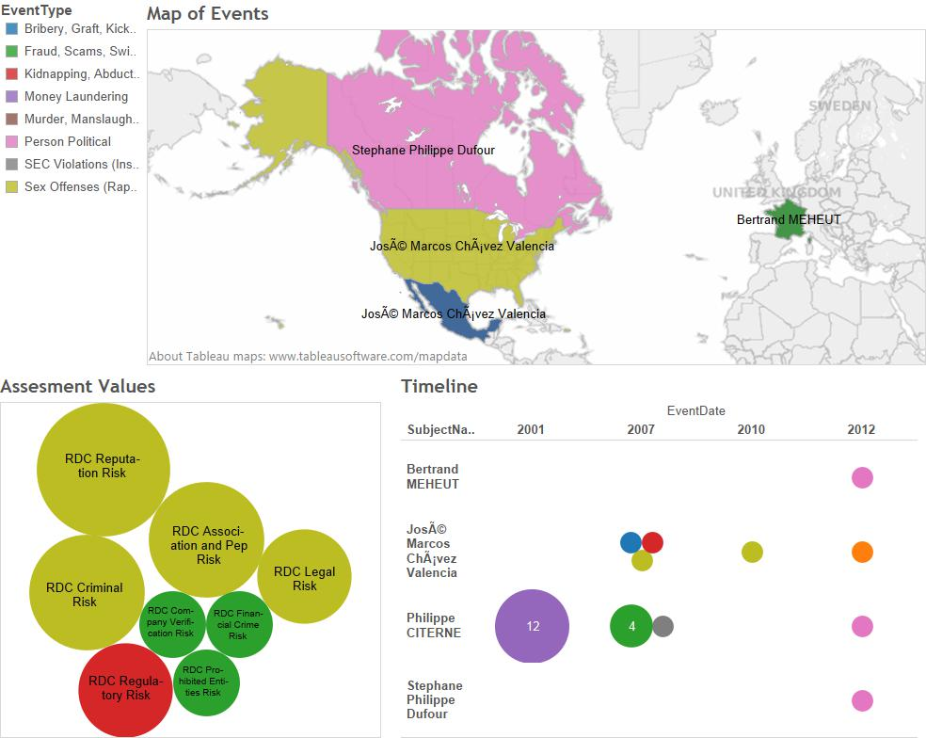
EXAMPLES OF DATA VISUALIZATION
Visualization Dashboards
Dashboards enables many different visualization formats to be presented to the user simultaneously instead of having to present one at a time

Slide 22
Data Visualization - case
Medicare is the federal health insurance program for people who are 65 or older, certain younger people with disabilities, and people with End-Stage Renal Disease
For the purpose of the Big Data Audit, the following was obtained:
Medicare patient claims and provider details for the 2010 fiscal year
National Provider Identifier (NPI) details
ICD-9-CM Diagnosis and Procedure Codes
the New Jersey census data for the year 2010
Department of Health for the State of New Jersey
American Hospital Directory
Social Network

Slide 23
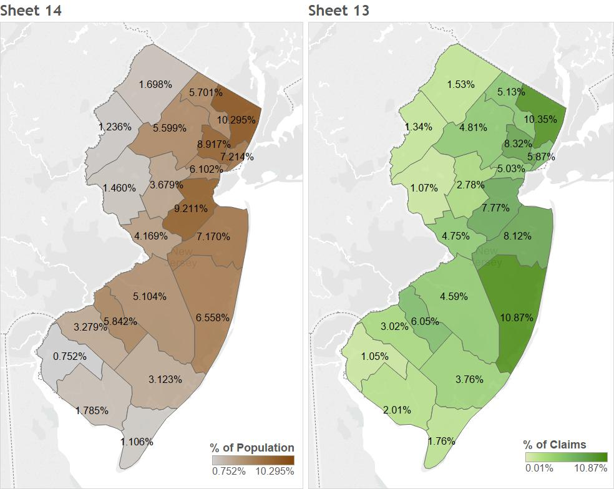
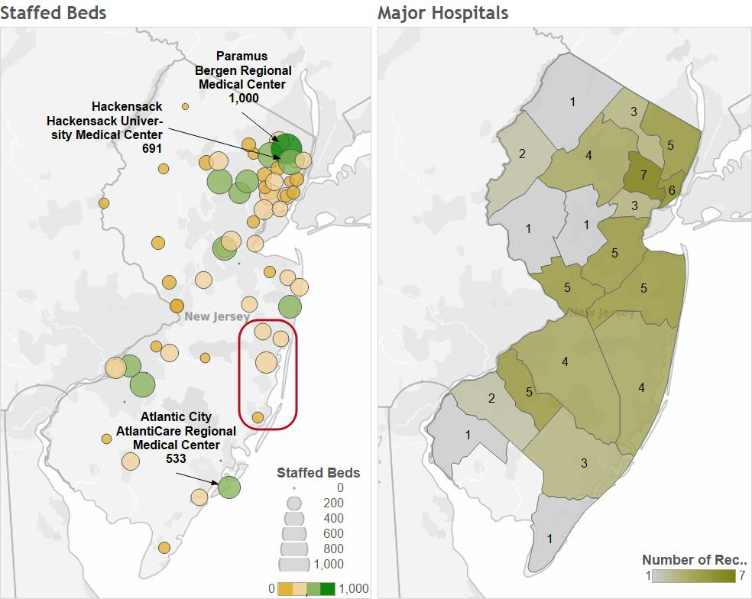
ANALYSIS AND RESULTS

Slide 24
ANALYSIS AND RESULTS

Slide 25
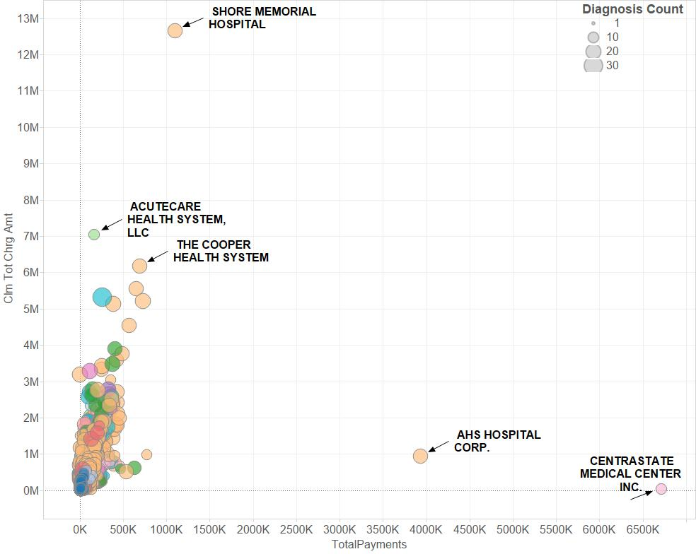

Slide 26
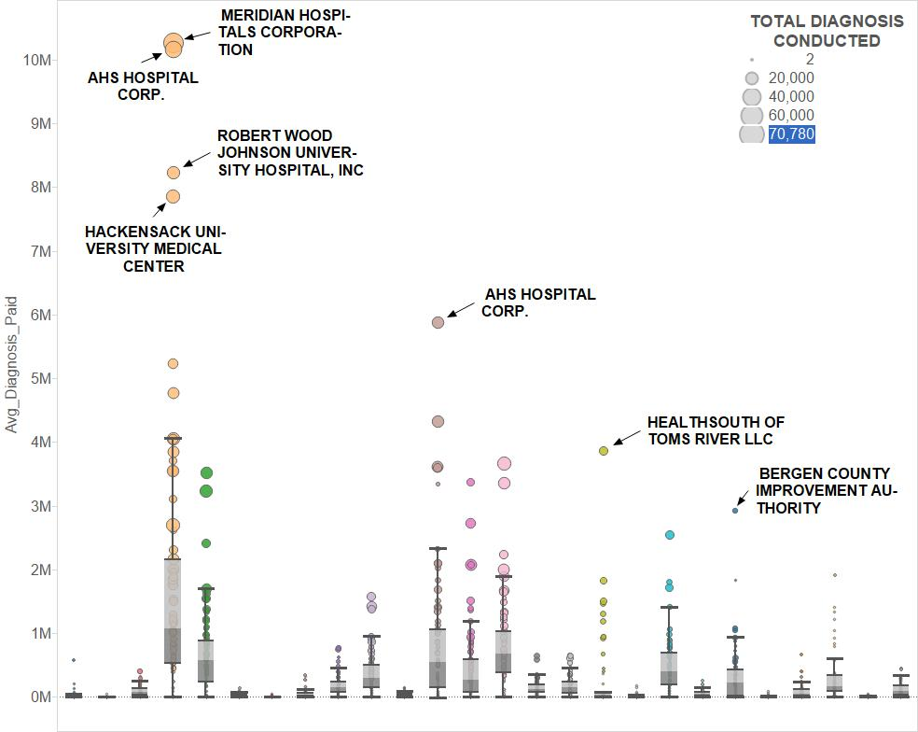

Slide 27
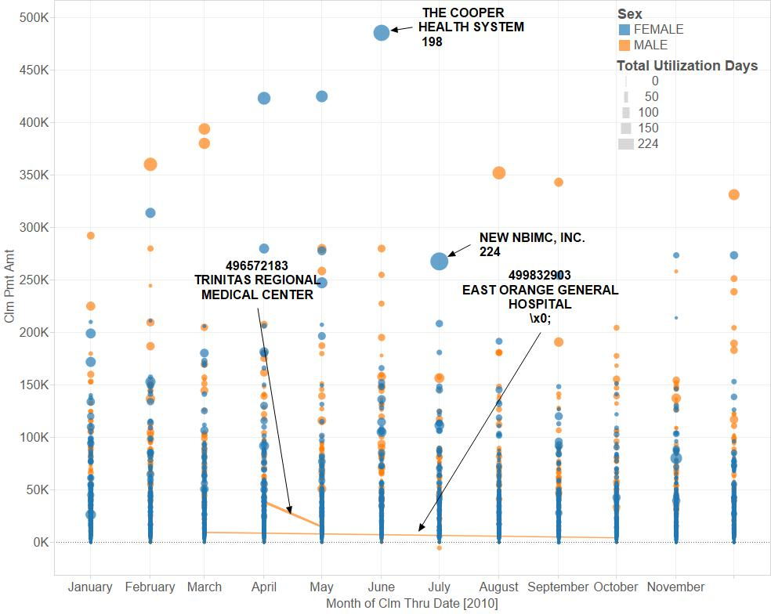

Slide 28
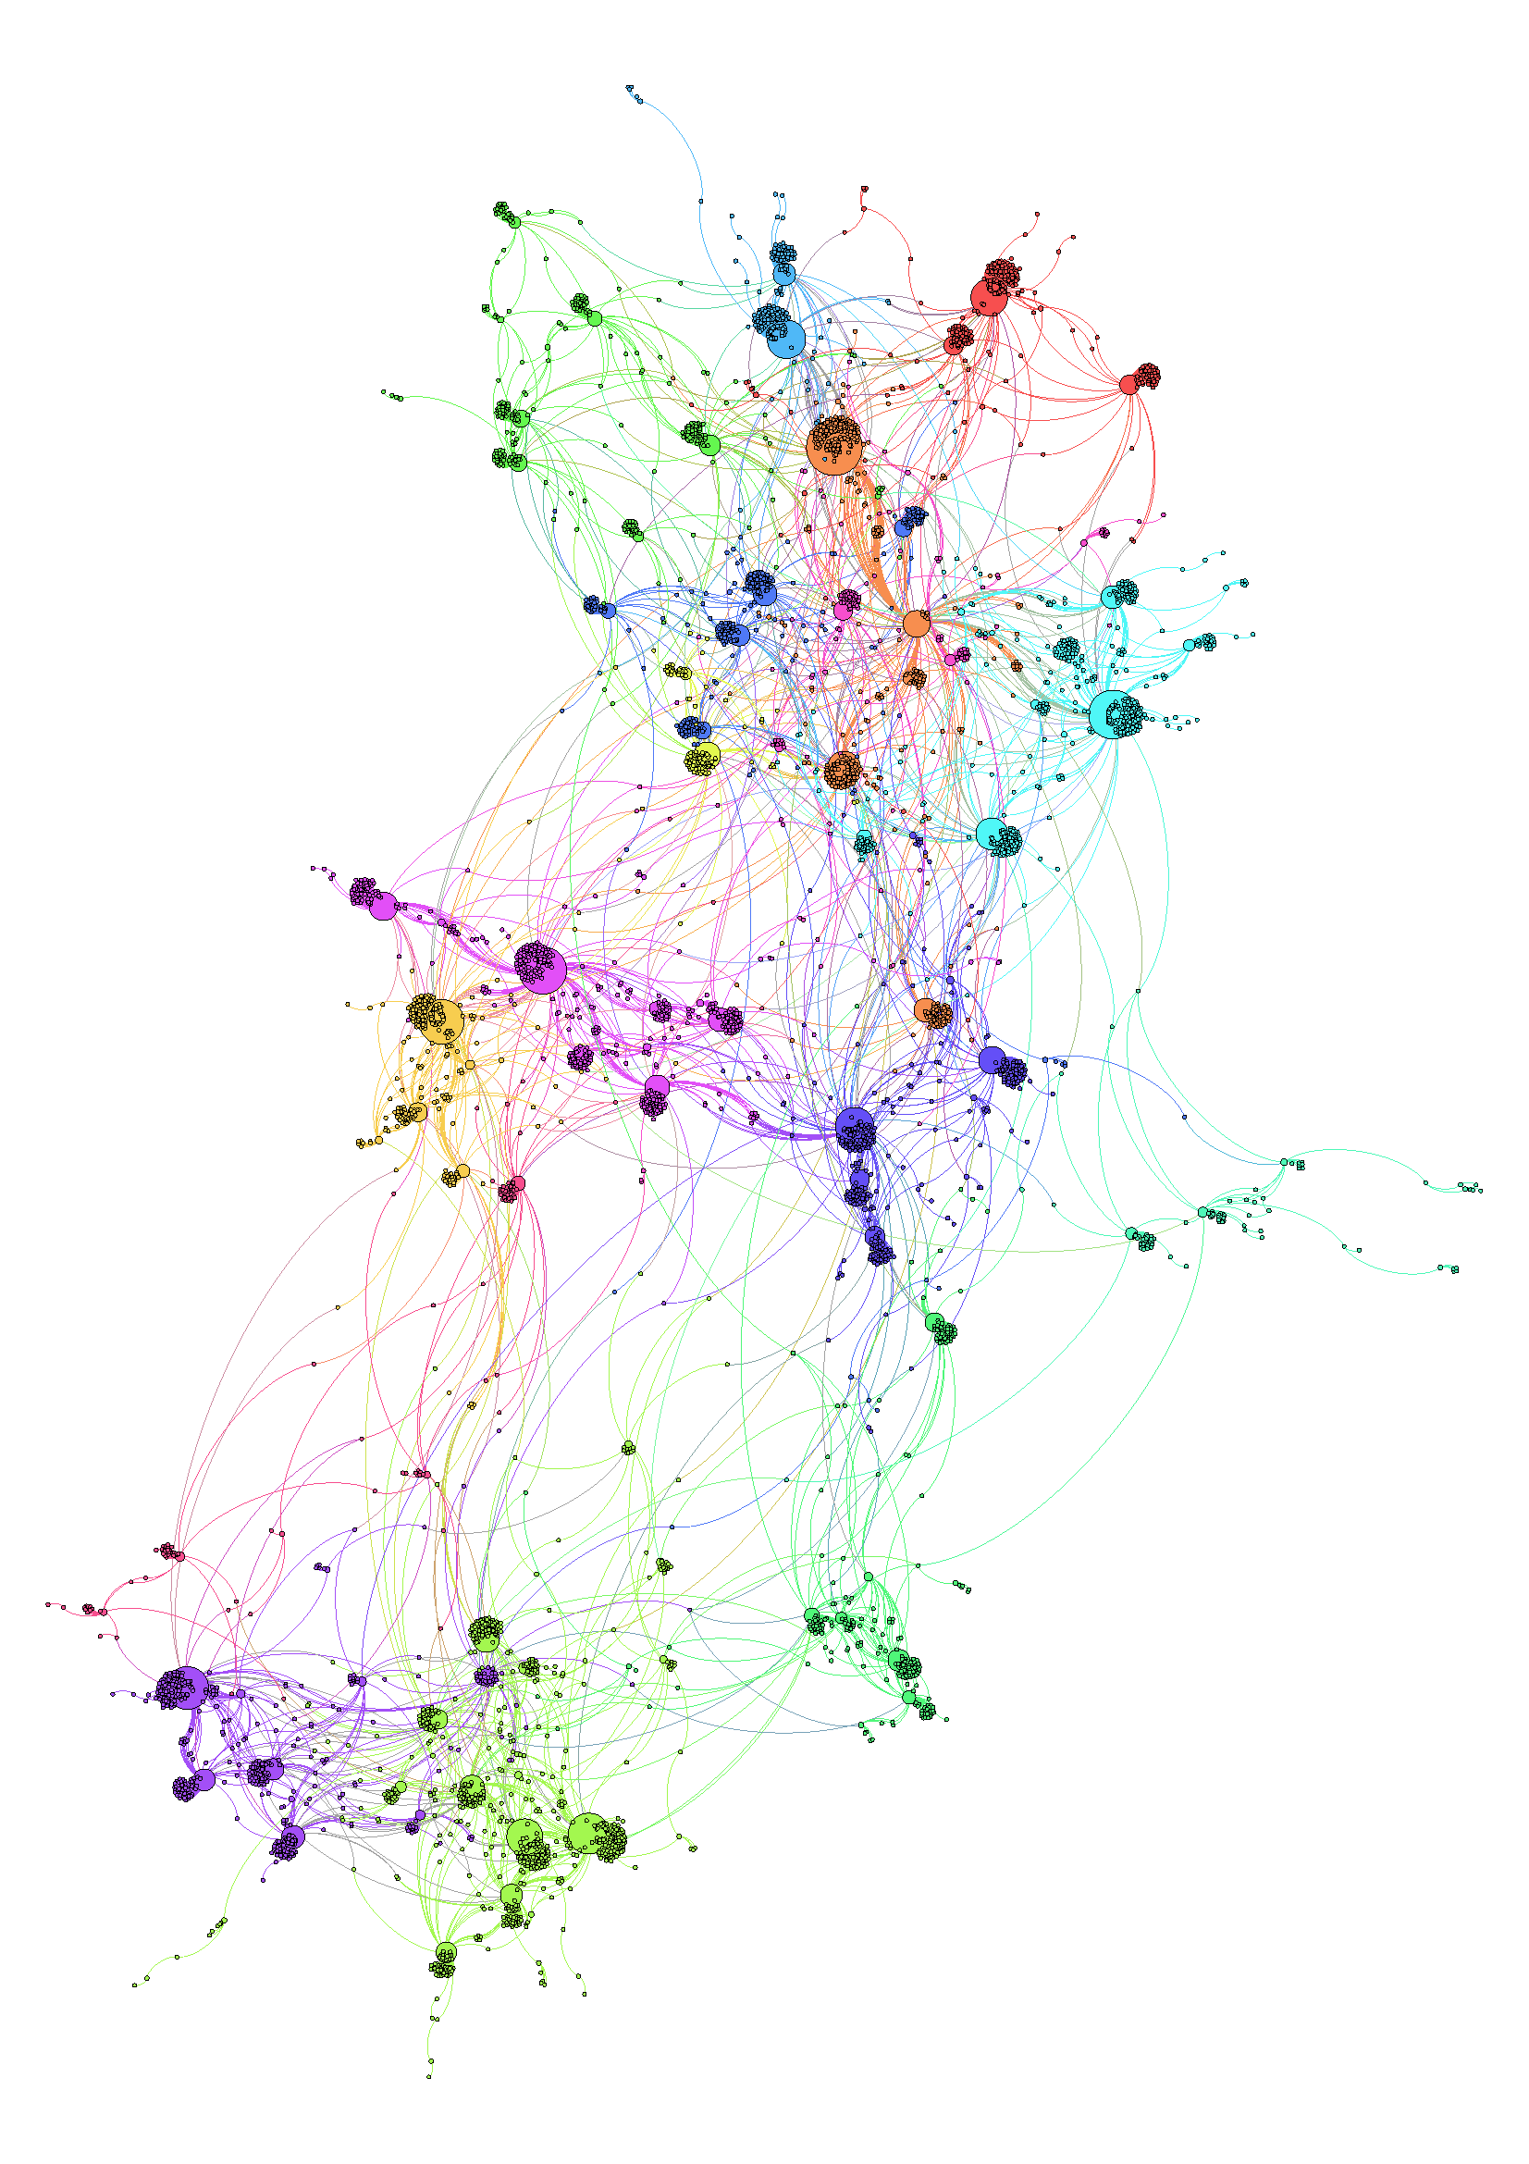
Provider 310001
Provider 310041

Slide 29
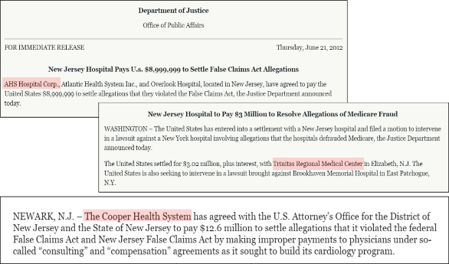
Big Data Audit – Data Visualization
 | Providers in Question | # Item was in Questions
1 | AHS Hospital Corp | 3
2 | Centerstate Medical Center Inc. | 3
3 | The Cooper Health System | 2
4 | Meridian Hospitals Corporation | 1
5 | Robert Wood Johnson University Hospital, Inc. | 1
6 | Hackensack University Medical Center | 1
7 | Health South of Toms River LLC | 1
8 | Acutecare Health Systems LLC | 1
9 | Trinitas Regional Medical center | 1
10 | East Orange General Hospital | 1
11 | Shore Memorial Hospital | 1
 | Providers in Question | # Item was in Questions
1 | AHS Hospital Corp | 3
2 | Centerstate Medical Center Inc. | 3
3 | The Cooper Health System | 2
4 | Meridian Hospitals Corporation | 1
5 | Robert Wood Johnson University Hospital, Inc. | 1
6 | Hackensack University Medical Center | 1
7 | Health South of Toms River LLC | 1
8 | Acutecare Health Systems LLC | 1
9 | Trinitas Regional Medical center | 1
10 | East Orange General Hospital | 1
11 | Shore Memorial Hospital | 1

