Slide 1
PAPER DISCUSSION:
The Fraud Diamond: Considering the Four
Elements of Fraud
David T. Wolfe and Dana R. Hermanson
The CPA journal

Slide 2
Introduction
Despite intense efforts to stamp out corruption, misappropriation of assets, and fraudulent financial reporting, it appears that fraud in its various forms is a problem that is increasing in frequency and severity.
Organizations are implementing tighter controls and broader oversight. The auditing profession has adopted more rigorous auditing standards and procedures, and software developers are adding continuous monitoring features to back-office systems. It remains unclear whether these efforts are sufficient to mitigate the fraud problem.

Slide 3
Introduction
Many studies suggest fraud is more likely to occur when someone has an incentive (pressure) to commit fraud, weak controls or oversight provide an opportunity for the person to commit fraud, and the person can rationalize the fraudulent behavior (attitude).
This three-pronged framework, commonly known as the “fraud triangle,” has long been a useful tool for CPAs seeking to understand and manage fraud risks..

Slide 4
A Different Way to Think
About Fraud Risks
The authors believe that the fraud triangle could be enhanced to improve both fraud prevention and detection by considering a fourth element.
In addition to addressing incentive, opportunity, and rationalization, the authors’ four-sided “fraud diamond” also considers an individual’s capability
  Capability: personal traits and abilities that play a major role in whether fraud may actually occur even with the presence of the other three elements

Slide 5
A Different Way to Think
About Fraud Risks
Many frauds, especially some of the multibillion-dollar ones, would not have occurred without the right person with the right capabilities in place
Opportunity opens the doorway to fraud, and incentive and rationalization can draw the person toward it. But the person must have the capability to recognize the open doorway as an opportunity and to take advantage of it by walking through, not just once, but time and time again

Slide 6
A Different Way to Think
About Fraud Risks
Using the four-element fraud diamond, a fraudster’s thought process might proceed as follows
  Incentive: I want to, or have a need to, commit fraud.
  Opportunity: There is a weakness in the system that the right person could exploit. Fraud is possible.
  Rationalization: I have convinced myself that this fraudulent behavior is worth the risks.
  Capability: I have the necessary traits and abilities to be the right person to pull it off. I have recognized this particular fraud opportunity and can turn it into reality.

Slide 7
A Different Way to Think
About Fraud Risks
For example, consider a company where the internal controls allow the possibility that revenues could be recorded prematurely by altering sales contract dates in the sales system. An opportunity for fraud exists, if the right person is in place to understand and exploit it. This opportunity for fraud becomes a much more serious problem if the company’s CEO, who is under intense pressure to increase sales, has the technical skills to understand that the control weakness exists, can coerce the CFO and sales manager to manipulate the sales contract dates, and can consistently lie to analysts and board members about the company’s growth. In the absence of such a CEO, the fraud possibility would never become reality, despite the presence of the elements of the fraud triangle. Thus, the CEO’s capabilities are a major factor in determining whether this control weakness will ultimately lead to fraud.

Slide 8
The Person with Capability
Based on one author’s experiences in investigating frauds for the past 15 years, there are several essential traits for committing fraud, especially for large sums or for a long period of time.
  First, the person’s position or function within the organization may furnish the ability to create or exploit an opportunity for fraud not available to others
  Second, the right person for a fraud is smart enough to understand and exploit internal control weaknesses and to use position, function, or authorized access to the greatest advantage
  Third, the right person has a strong ego and great confidence that he will not be detected, or the person believes that he could easily talk himself out of trouble if caught.
  Fourth, a successful fraudster can coerce others to commit or conceal fraud
  Fifth, a successful fraudster lies effectively and consistently
  Finally, a successful fraudster deals very well with stress

Slide 9
Dealing with Capability
Appreciating the importance of capability as a fourth element of fraud is only part of the challenge. The next task is to address capability when assessing fraud risk, and to use knowledge about fraud capability to prevent or detect fraud. Beyond considering incentive, opportunity, and rationalization, the following steps could shed light on capability.
Explicitly assess the capabilities of top executives and key personnel
  The audit committee member, corporate accountant, or auditor should focus on the personality traits and skills of top executives and others responsible for high-risk areas when assessing fraud risk or seeking to prevent or detect fraud. Routine background checks on new employees can identify past criminal convictions.
  In assessing individuals’ traits and abilities, several methods of gathering information may be helpful
    First, there is no substitute for spending time with a person.
    Second, look for signals in the “little things”
    Finally, pay attention to what others say about a person

Slide 10
Dealing with Capability
If there are concerns about capability, respond accordingly
If someone’s capabilities present a significant risk factor, respond with stronger controls or enhanced audit testing. For example, if the sales vice president is overly aggressive, competitive, and obsessed with hitting monthly sales quotas, there may be a need for extra-tight controls over revenue recognition or expanded testing of sales during the annual audit.
In addition, implementing a periodic rotation of routine, but key, functions among staff can minimize the opportunities for fraud gained from long-term knowledge of the function and its controls.
When designing detection systems, it is important to consider who within the organization has the capability to quash a red flag, or to cause a potential inquiry by internal auditors to be redirected. Cynthia Cooper, the internal auditor at WorldCom credited with discovering the massive fraud, has described in Time magazine how CFO Scott Sullivan had exercised his position and seniority to dissuade her team from looking into certain areas that later proved to have been infested with massive fraud.

Slide 11
Dealing with Capability
Reassess the capabilities of top executives and key personnel
Assessing capability and responding to concerns should not be viewed as onetime exercises. Continuous updating of the capability assessment and response is warranted for two reasons
  First, people can develop new capabilities over time, especially if they are climbing the corporate ladder and growing professionally. Just because someone did not have enough power or knowledge of an area to commit fraud in the past, there is no guarantee that the person will not develop such power or knowledge in the future. Their capability to commit fraud may increase, and additional controls or scrutiny may be warranted.
  Second, organizational processes, controls, and circumstances change over time. As a result, some people may be better suited to commit fraud in the new environment, even though they were not capable under previous conditions.

Slide 12
Beyond Standards
In the final analysis, recent legislation, increased enforcement, regulatory oversight, broader controls, improved auditing standards, and sophisticated monitoring technology are all steps in the right direction and will contribute to preventing and detecting fraud
Limiting this effort to current standards and practices may not be enough, however, especially for auditors.
Accordingly, if capability could play a role in influencing or magnifying the other fraud elements, other checks and balances or detection systems should be implemented, or an auditor should expand audit scope, procedures, and testing for potential fraud

Slide 13
PAPER DISCUSSION:
Innovation and Practice of Continuous Auditing
David Y. Chan and Miklos A. Vasarhelyi

Slide 14
Introduction
The objective of financial reporting is to provide information that is useful to management and stakeholders for resource allocation decisions (FASB, 2006).
For financial information to be useful, it should be timely and free from material errors, omissions, and fraud. In the real time economy (Economist, 2002; Vasarhelyi et al.,2010), timely and reliable financial information is critical for day to day business decisions regarding strategic planning, raising capital, credit decisions, and supplier or vendor partnerships.
Advances in accounting information systems such as the advent of enterprise resource planning (ERP) systems have enabled the generation of real time financial information

Slide 15
Introduction
However, the practice of traditional auditing has not kept pace with the real time economy, and the state of the art of assurance has lagged.
The lack of support for real time assurance may be primarily attributed to the manual nature of traditional audit procedures.
Manual audit procedures are labor and time intensive. These constraints limit audit frequency to an annual occurrence. As a result, management and stakeholder reliance on real time financial information can lead to adverse resource allocation decisions.

Slide 16
Introduction
These time and effort constraints can be alleviated through the use of technology and automation.
Reliance on technology throughout the audit process can reduce labor intensiveness (Elliott, 1998) and increase production efficiencies (Menon and Williams, 2001).
Innovation of the traditional audit process using an automation technology such as continuous auditing (CA) will be an essential step toward the development of real time assurance.
  In continuous auditing, the methodologies enhance the delivery of auditing services by making the audit process more efficient and effective through the use of technology and automation.

Slide 17
Introduction
The continuous auditing paradigm introduces innovation to the traditional practice of auditing along seven major dimensions
  Continuous or more frequent audits
  Proactive audit model
  Automation of audit procedures
  Evolution of the work and role of the auditors
  Change in the nature, timing, and extent of auditing
  Use of data modeling and data analytics for monitoring and testing
  Change in nature and timing of audit reporting
Collectively, these seven innovation dimensions aid in enabling real time assurance and enhancing the reliability of real time financial information.

Slide 18
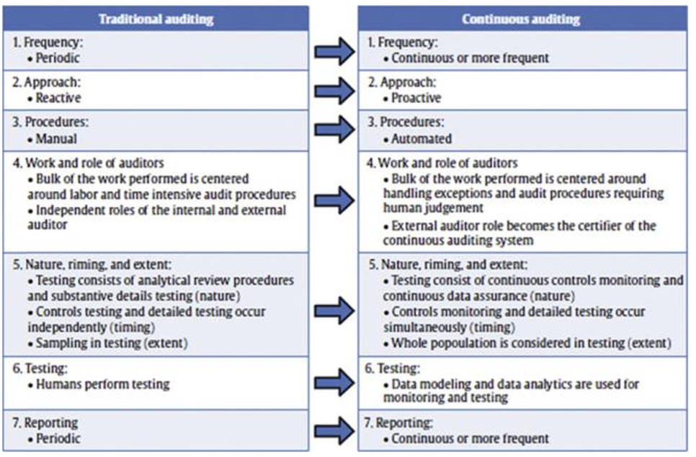
Introduction
Traditional Auditing vs. Continuous Auditing Methodology

Slide 19
Continuous Auditing
Innovations in Audit Methodology
The concept of continuous auditing was first introduced by Groomer and Murthy (1989) and Vasarhelyi and Halper (1991).
Since then, CA has been progressively prototyped and/or adopted at such institutions as AT&T Corp., Siemens, HCA Inc, Itau Unibanco, IBM, HP, MetLife, and Proctor & Gamble
This interest in continuous auditing implies that management and their auditors recognize that the traditional audit paradigm is outdated and innovation to the practice of auditing is necessary in the real time economy.

Slide 20
1. Continuous or
Frequent Audit
Auditing continuously or in real time may seem ideal. However, the real time audit can impact the operation of the accounting information system and may not always be cost-effective.
As a result, real time continuous auditing will tend to occur in high risk business processes
  For example, in industrial firms it may be prudent to continuously audit the higher risk treasury disbursement process in real time. On the other hand, it may be sufficient to audit the lower risk prepayment expense process in periodic or frequent cycles.

Slide 21
1. Continuous or
Frequent Audit
(Du and Roohani, 2007) propose a continuous auditing cycle model that mirrors the traditional audit engagement period. A cycle starts when the auditor connects into the accounting information system and ends when the auditor disconnects. The auditor can connect into the system after a period of time or a number of transactions.
However, Pathak et al. (2004) finds a continuous audit cycle dependent on transaction volume may be more cost-effective. For example, an audit will be triggered after a number of accounts payable transactions have entered into the accounting information system

Slide 22
2. Proactive Audit
In the traditional audit paradigm, accounting information is audited on an annual basis. As a result, material errors, omissions, or fraud can go undetected for months before detection by an audit
In contrast, a continuous audit occurs on a more frequent or continuous basis. Continuous monitoring of internal controls and testing of transactions allows the auditor to actively detect and investigate exceptions as they occur rather than to react after the exception has long occurred
As accounting information systems become increasingly complex and sequential business processes intertwine (ex. manufacturing, inventory, sales, etc.), proactive auditing may help preclude the transmission of errors, omissions, and fraud from process to process.

Slide 23
3. Automation of Audit Procedures
A traditional audit is labor and time intensive due to the preponderance of manual audit procedures.
Automation of audit procedures utilizing continuous auditing methodology can alleviate these constraints
However, the automation of all traditional audit procedures may not be immediately feasible. Audit procedures requiring complex judgment and professional skepticism will still require manual performance by the auditor in the continuous auditing environment
However, advancements in artificial intelligence may someday lead to automation of audit procedures requiring human judgment and professional skepticism.

Slide 24
3. Automation of Audit Procedures
For automated audit procedures to be effective, standardization of data collection and formalization of internal control policies is necessary
If the data entered into the accounting system is not standardized, the auditor would have to manually clean the data before automated audit procedures can be performed.
The tedious process of manual data cleaning will partially offset the benefits and efficiencies of automated audit procedures
Furthermore, internal control policies within a company should be well defined or formalized in order to support automated monitoring of internal control violations.

Slide 25
4. Work and Role of Internal and External Auditor
Vasarhelyi et al. (2004) proposed four levels of audit objectives for continuous assurance and analytical monitoring;
Level 1: Transactional Verification
  Detection of business transaction irregularities
Level 2: Compliance Verification
  Substantiation that measurement rules (ex. GAAP) have been properly applied
Level 3: Estimate Verification
  Evaluation of accounting estimate reasonableness
Level 4: Judgment Verification
  Application of complex high level judgment for overall audit risk reduction valuation of accounting estimate reasonableness

Slide 26
4. Work and Role of Internal and External Auditor
Audit procedures used for transaction and compliance verification are automated in the continuous auditing environment. The automation of transaction and compliance audit procedures shifts the auditor’s work to more complex audit objectives, such as dealing with estimate and judgment verifications that require auditor judgment and professional skepticism.
Hence, the auditor’s main role in the present continuous auditing environment involves investigating irregularities/exceptions from the CA system and dealing with audit procedures requiring judgment and professional skepticism.

Slide 27
5. Nature, Timing, and Extent of Testing
In a traditional audit, manual internal control and substantive detailed testing are periodically performed to evaluate management’s assertions. In contrast automated continuous controls monitoring (CCM) and continuous data assurance (CDA) are used in a continuous audit (Alles et al., 2006, 2008a,b) (Nature).
Generally, in traditional auditing, internal control testing occurs in the planning and substantive detail testing occurs in the fieldwork stage of the audit. Conversely, internal controls monitoring and transaction data testing occur simultaneously in a continuous audit environment (Timing).
A traditional audit relies on the use of sampling due to the labor and time intensiveness of manual testing. In contrast, a continuous audit considers the whole population of transactions in monitoring and testing (Extent).

Slide 28
6. Data Modeling and Data
Analytics for Monitoring and Testing
Basic statistical techniques such as ratio, trend, and regression analysis are used for analytical procedures in a traditional audit (Stringer and Stewart, 1986).
In a continuous audit, data modeling and data analytics techniques are used for analytical procedures. Data modeling and data analytics techniques emerged from statistics, data mining, and machine learning research.
Data modeling involves the use of historical audited transaction data and account balances to create benchmarks. Data analytics are used to compare present unaudited transactions and account balances against the benchmarks created by data modeling.
In the continuous auditing environment, the processes of monitoring and testing consist of comparing current observations with benchmarks (Vasarhelyi et al., 2004).

Slide 29
7. Audit Reporting
Information generated by the accounting information system is deemed to be free from material errors, omissions, and fraud if there are no audit exception reports indicating otherwise.
If an exception report indicates a material internal control violation or transaction anomaly, that exception must be cleared before financial information can be assured.
From the external audit perspective, a certified clean audit opinion or report can be issued on the CA system if no abnormalities or interventions were detected
However, assuring both financial reporting and control and data integrity would require substantial departure from today’s regulations. The external auditor would have to assume (and be permitted to) a role of monitorer and probably have to provide a different (although complementary) form of assurance product.

Slide 30
Continuous Audit Stages and Process
The continuous audit consists of four stages;
Stage 1: Automation of audit procedures
Stage 2: Data modeling & benchmark development
Stage 3: Data analytics, & Stage
Stage 4: Reporting

Slide 31
Conclusion
Continuous auditing is a technological innovation of the traditional audit process. The concept of CA has been around for nearly two decades, however, CA in practice is quite novel
CA innovates and advances the practice of traditional auditing by using technology and automation
The discussions in the paper lead to a set of propositions concerning the environment of future assurance:

Slide 32
Conclusion
The continuous audit paradigm will progressively integrate and eventually replace the traditional audit paradigm.
Real time continuous auditing will occur in high risk business processes and frequent audits will occur in other business processes.
In the CA environment, information systems will have a lower frequency of errors occurring over a more limited set of sequential processes.
Standardization of data collection and formalization of internal control policies is essential for audit automation
The auditor’s role will evolve from performing tedious audit procedures to investigating irregularities/ exceptions and dealing with audit procedures requiring judgment and professional skepticism.

Slide 33
Conclusion
In the CA paradigm, the external auditor’s role may eventually evolve to become an independent certifier of internal audit’s CA system.
Consideration of the whole population of transactions in monitoring and testing can enhance the effectiveness of an audit and increases the probability that material errors, omissions, and fraud may be detected.
Dual level analysis of transaction data and account balances will be used in the CA environment to help detect fraud or collusion by management.
Initial application of CA will occur in business processes where there is no barrier to data access. The contribution of this paper to the CA literature is threefold

